Slide 1
AI in the Practice of Law
Play with AI like your career
depends on it (it does)
Lucian T. Pera
Adams & Reese, LLP

Slide 2
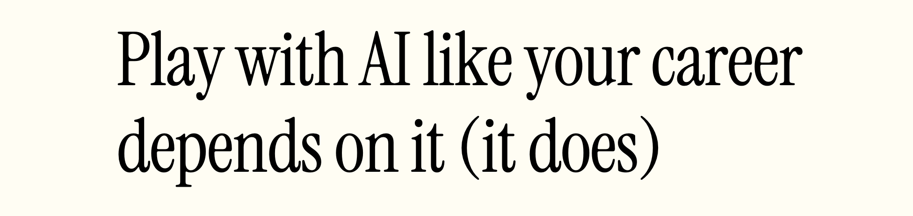
Today’s moral… maybe.

Slide 3
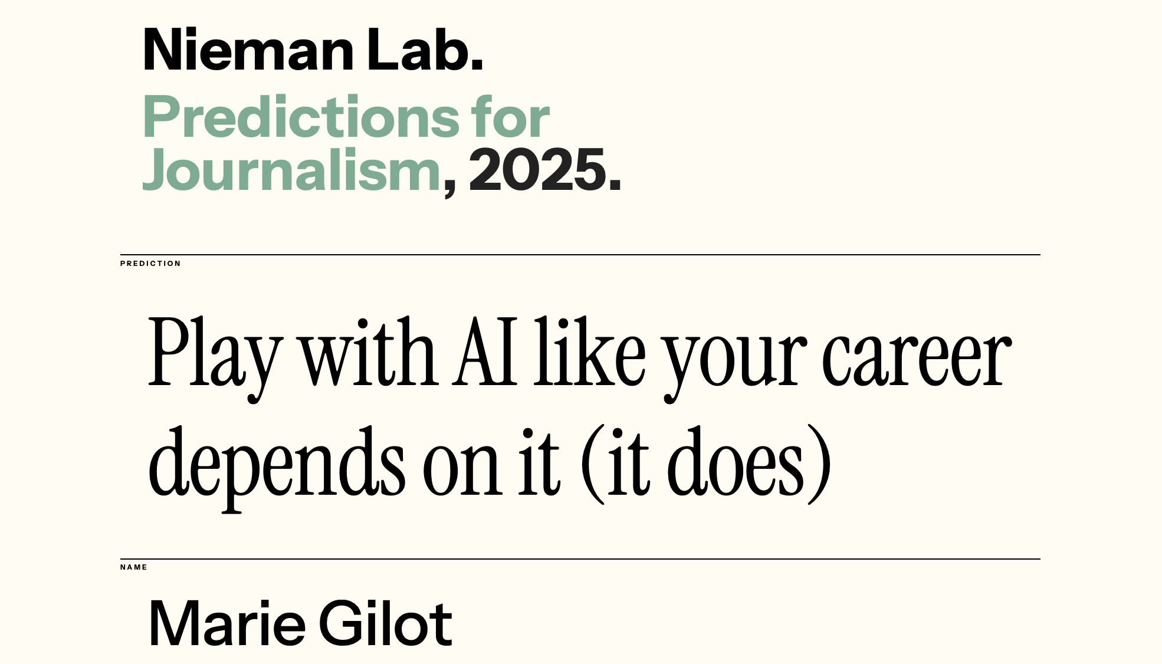
Today’s moral… maybe.

Slide 4
AI and legal ethics
The explosion of ChatGPT
  Nov. 30, 2022: ChatGPT debuts
  October 2025: ChatGPT had about 190-220 million daily active users; processes over 2.5 billion prompts each day
    ChatGPT estimate: probably 500-600 millions daily active users of all genAI products
  Estimates: anywhere from 40-70% of U.S. lawyers are using genAI products daily

Slide 5
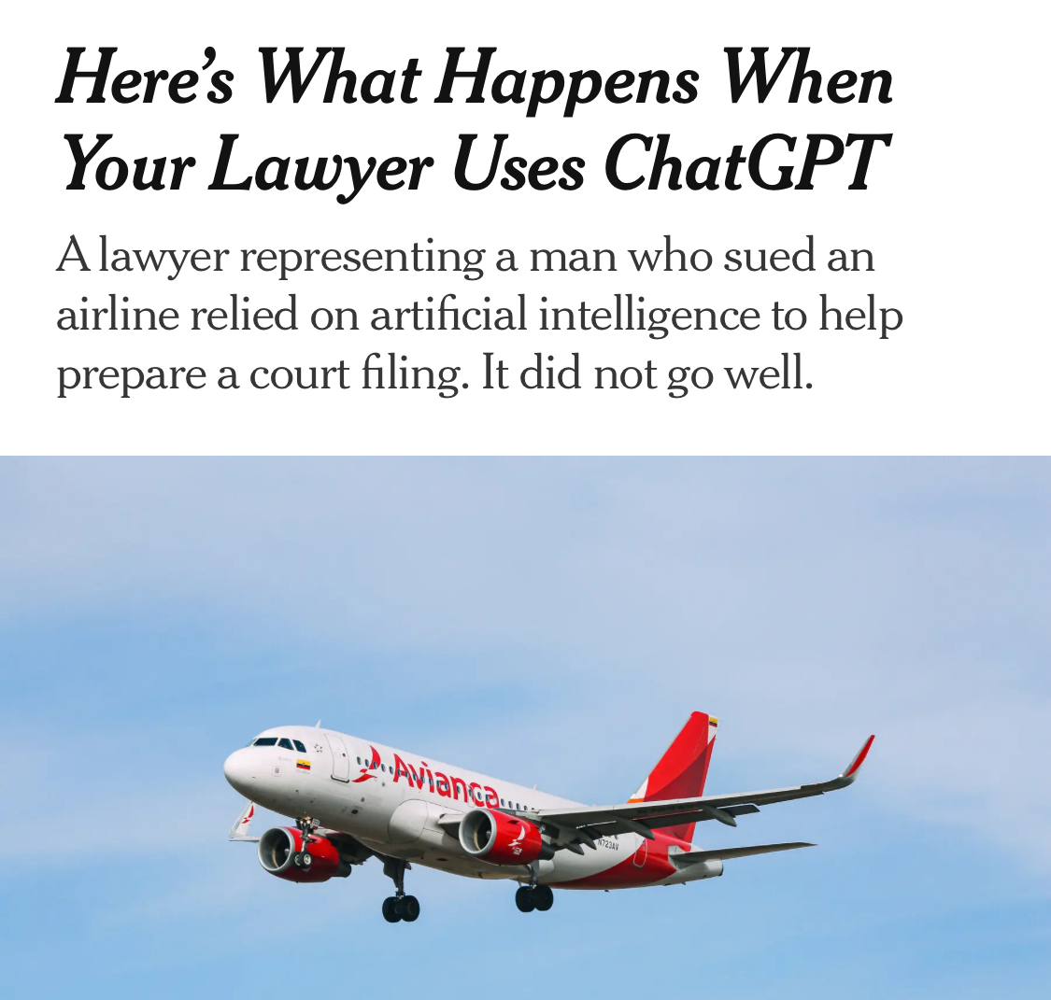
AI and legal ethics
And the lawyer hijinks began quickly….
  Mata v. Avianca, Inc., No. 22-CV-1461 (PKC), 2023 WL 4114965 (S.D.N.Y. June 22, 2023).

Slide 6
What is Artificial Intelligence?
Artificial Intelligence (AI) is a machine-based system that can generate predictions, recommendations, or decisions that influence real or virtual environments.
Statistical modeling and algorithmic functions + inferences
Data Input
Output
Notes:
AI works through statistical modeling through vast amounts of training data. Machine learning is used to find patterns in the data and to infer certain outputs. The quality of the data used to train the AI system is critical: the data is what influences the AI’s behavior (“garbage in, garbage out”).

Slide 7




What is Artificial Intelligence?
Large Language Models (LLMs) are a type of AI that has been trained on a vast amount of data and can understand and generate human-like text (generative AI).
Nov. 2022
Feb. 2023
March 2023
March 2023
Notes:
ChatGPT, Google Gemini, Claude, and others are all large language models
July 2025: ChatGPT had about 122 million daily active users
ChatGPT estimate: probably hundreds of millions daily active users of all genAI products
Estimates: anywhere from 40-70% of U.S. lawyers are using genAI products daily
July 2025: ChatGPT had about 122 million daily active users
ChatGPT estimate: probably hundreds of millions daily active users of all genAI products
Estimates: anywhere from 40-70% of U.S. lawyers are using genAI products daily
July 2025: ChatGPT had about 122 million daily active users
ChatGPT estimate: probably hundreds of millions daily active users of all genAI products
Estimates: anywhere from 40-70% of U.S. lawyers are using genAI products daily

Slide 8
Generative AI (“GenAI”)
Prompt engineering is the process of writing effective instructions for a model.
Answer: The Loper Bright Enterprises v. Raimondo ruling, decided by the U.S. Supreme Court on June 28, 2024, is a landmark decision that overturned the Chevron doctrine, a foundational principle in administrative law for the past 40 years.
Prompt: Can you provide a brief summary of the Loper Bright ruling?

Slide 9
AI Agents and Agentic AI are here.
An AI agent is an AI system that can accomplish a specific goal or complete a task autonomously with limited supervision.
Agentic AI is a different type of AI system that is highly autonomous and able to handle complex tasks that require reasoning, problem-solving, and adapting to new situations.
Perception + Reasoning + Action + Learning
Output
Notes:
AI agents are built to do specific tasks and do not necessarily have a wide range of autonomy.
Agentic AI, on the other hand, is highly automated, gpa driven, and acts independently. Generic AI operates in four key stages:
Perception: It gathers data from the world around it.
Reasoning: It processes this data to understand what’s going on.
Action: It decides what to do based on its understanding.
Learning: It improves and adapts over time, learning from feedback and experience.

Slide 10
How is AI being used in the legal profession?
Law students use AI for…
Legal research and case summaries
Turning readings into podcasts to make the information more digestible
Exam prep (creating quizzes, finding patterns, comparing answers to model answers, etc.)
Companionship
Output

Slide 11
How is AI being used in the legal profession?
Attorneys use AI for…
  Summarizing lengthy documents (e.g., depositions, opinions)
  Legal research
  Drafting, editing, or proofing a pleading or contracts
  Due diligence review of contracts
  Analyzing documents (e.g., appellate brief, contract)
  Preparing a deposition examination outline
  Translating legalese for clients or consumers
  Marketing (e.g., turn article into social media posts)
  E-discovery review
Output

Slide 12
How is AI being used in the legal profession?
In the courts, AI is used to…
Performing legal research
Drafting routine orders
Managing court schedules
Streamlining document processing (tagging and indexing) by Clerk’s offices
Inform judges’ decision-making through data analysis (e.g., sentencing)
Output
Notes:
Example:
A Tulane University study assessed the use of AI tools when they helped inform judges’ decision-making in more than 50,000 convictions in the State of Virginia. AI software was used to score each offender’s risk of re-offending and then advise judges on sentencing options: incarceration or alternative punishments. The study found that the AI tool could help to correct gender and racial bias that may come into play in judges’ discretionary decisions.
The tools would generate recommendations, but final sentencing decisions were made by human judges.
Another example:
The New York State Parole Board is one in several states which uses the actuarial tool COMPAS Risk and Needs Assessment to support decisions on parole and assess the likelihoods of recidivism.

Slide 13
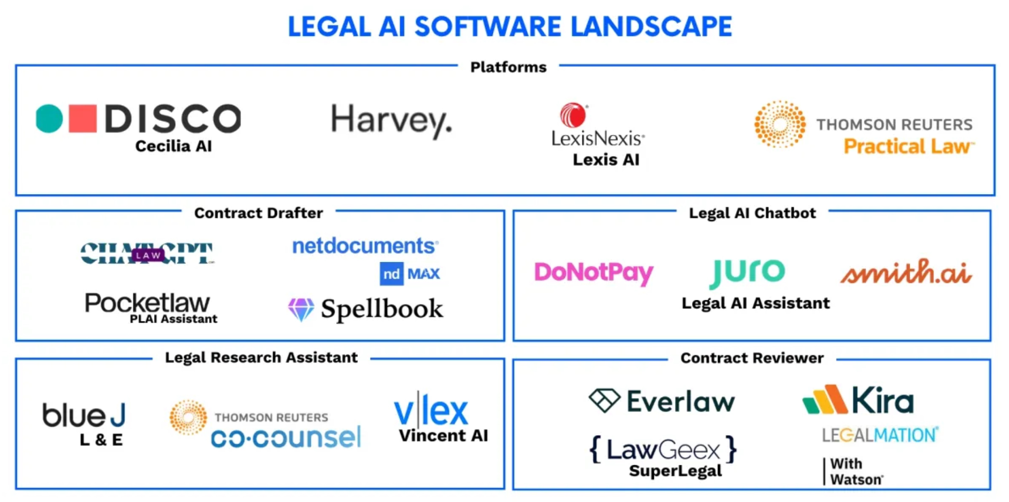
Output
Source: Clio
Notes:
various e-discovery tools

Slide 14
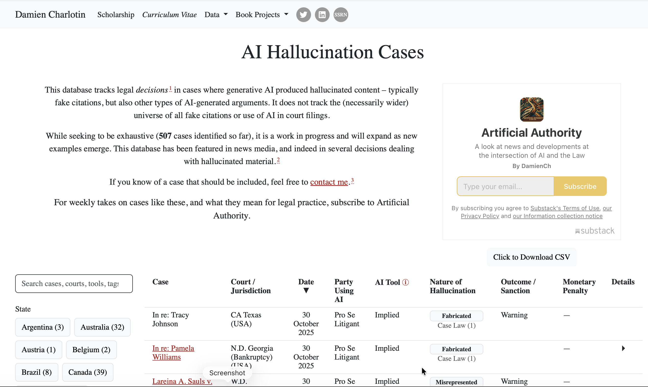
Cautionary Tales
Output
  Source: https://www.damiencharlotin.com/hallucinations/
Notes:
Hallucinations:
Sycophancy, in which chatbots agree with and excessively praise users, is a trait they’ve manifested partly because their training involves human beings rating their responses.
cross-chat memory: when you start a fresh chat, it’s actually not fresh. It’s actually pulling in all of this context from prior convos; easy for genAI to all of a sudden turn into a co-counsel or business partner

Slide 15
Cautionary Tales
  Mata v. Avianca, Inc., No. 22-CV-1461 (PKC), 2023 WL 4114965 (S.D.N.Y. June 22, 2023).
  Mid Cent. Operating Eng’rs Health & Welfare Fund v. HoosierVac LLC, No. 2:24-cv-00326-JPH-MJD, 2025 WL 574234 (S.D. Ind. Feb. 21, 2025)
  Wadsworth v. Walmart Inc., No. 2:23-cv-118-KHR, 2025 WL 608073 (D. Wyo. Feb. 24, 2025)
  Kohls v. Ellison, No. 24-cv-3754 (LMP/DLM), 2025 WL 66765 (D. Minn. Jan. 10, 2025) (expert witness)
  Shahid v. Esaam, No. A25A0196, 2025 WL 1792657 (Ga. Ct. App. June 30, 2025) (trial judge)

Slide 16
AI and legal ethics
Ethics guidance so far includes:
  ABA Formal Opinion 512 (July 29, 2024), https://www.americanbar.org/content/dam/aba/administrative/professional_responsibility/ethics-opinions/aba-formal-opinion-512.pdf
  Opinions from: Alaska, D.C., Florida, Kentucky, Mississippi, Missouri, New Mexico, New York, North Carolina, Pennsylvania/Philadelphia, Texas, and West Virginia
  Other forms of ethics guidance from: Arizona, California, Illinois, Michigan, Minnesota, New Jersey, New York, Texas, Virginia, and USPTO

Slide 17
AI and legal ethics
Ethics guidance also includes:
  Judicial ethics opinions from Michigan and West Virginia
  Plus court rules and orders
    Responsible AI in Legal Services (RAILS), Duke Center on Law and Tech, https://rails.legal/resource-ai-orders/ (citing 108)
    Artificial Intelligence Court Order Tracker, Ropes & Gray, https://www.ropesgray.com/en/sites/artificial-intelligence-court-order-tracker (citing 180)

Slide 18
AI and legal ethics
Sources of law governing lawyer obligations concerning AI
      Standard of care
      Fiduciary duty
      Statutory duties (e.g., federal and state deceptive trade practices acts)
      Contracts (e.g., outside counsel guidelines)
      New court rules and standing orders
      Other law on AI

Slide 19
AI and legal ethics
Ethics rules touching on AI use
      Competence (Rule 1.1)
      Diligence (Rule 1.3)
      Client Communications (Rule 1.4)
      Fees (Rule 1.5)
      Confidentiality (Rules 1.6 and 1.9)
      Prospective clients (Rule 1.18)
      Candor toward tribunals (Rule 3.3)
      Supervision (Rules 5.1 and 5.3)
      Unauthorized Practice of Law (Rule 5.5)
      Advertising (Rule 7.1)

Slide 20
AI and legal ethics
Two key principles – Competence and Confidentiality
  Competence (mainly Rules 1.1 and 1.3)
    Fully understand each tool you use as a lawyer—does it contain or rely on AI? How does it work? Is it built with lawyers in mind?
    Training and supervision (Rules 5.1 and 5.3)
    Check your (AI’s) work!!!

Slide 21
AI and legal ethics
Two key principles – Competence and Confidentiality
  Confidentiality (mainly Rules 1.6 and 1.9(c))
    How is client confidential information protected?
      When submitted to tool; when used or held or trained on by tool; how output is used
    Client consent?
    Tool’s TOS—any obligation of confidentiality? Is it sufficient?
    Firm policies (or OCGs) on confidential information use

Slide 22
AI and legal ethics
May a lawyer ethically…
  Use ChatGPT to draft a brief or pleading?
    How about Westlaw’s CoCounsel?
  Use ChatGPT to do legal research?
    How about Westlaw’s Precision AI?
Guidelines?
  Generic tools v. law- or lawyer-specific tools or vendors?
  Free v. paid?
Notes:
ChatGPT:
Has she reviewed the OpenAI TOS?
Is she using the free or the paid service?
Is she checking over the pleading herself?
Does it matter if she gives ChatGPT client information that should go into the complaint?
Google
Free Google—no confidentiality; Paid Google; some confidentiality
Competence concerns
Westlaw
TOS--any obligation of confidentiality?
Use of Precision AI v. plain research v. Practical Law?
Grammarly
Does have AI components?
Confidentiality?
Otter.ai?
Read TOS?
Wiretapping laws? Does she need consent of all parties?
Should she seek consent? Or make disclosure?
What if client uses tool? Or employee of client?
How about use with witnesses in interview? It result work product?
AI tools to draft templates
What information will it ingest?
What will it do with information? Any leakage?
What will lawyers/others do with output?

Slide 23
AI and legal ethics
Q: Is it ethical for Lawyers to use AI in drafting a brief?
From Perplexity:
The ethical use of AI in drafting legal briefs remains a gray area. While AI can potentially improve efficiency, it cannot replace a lawyer’s professional judgment, ethical responsibilities, and duty to clients. Lawyers considering the use of AI should proceed with causation, ensure thorough human oversight, and stay informed about evolving ethical guidelines and court rules regarding AI use in legal practice.

Slide 24
AI and legal ethics
Q: Is it ethical for Lawyers to use AI in drafting a brief?
From ChatGPT:
Using AI in drafting a legal brief is not inherently unethical, but lawyers must exercise diligence in verifying its output, maintaining confidentiality, and ensuring accuracy. AI should be treated as an assistive tool rather than a replacement for legal expertise.

Slide 25
AI and legal ethics
Considerations in lawyer use of an AI tool
  Lawyer competence
    Does it require use of some AI tools? Does it prohibit use of some AI tools?
    How can we tell the difference?
  Role of the client in lawyer AI use
    Is disclosure to the client required?
    Is client consent required?
  Tool-by-tool, use-case-by-use-case analysis needed
    Meeting bots
    Contract or document analysis tools
    Predictive analytics

Slide 26
AI and legal ethics
Diligence in adoption or use of an AI tool
  Review of TOS
    Evan Harris & David W. Tollen, “Fine print face-off: which top large language models provide the best data protection terms? (352),” https://www.legalevolution.org/2024/04/fine-print-face-off-which-top-large-language-models-provide-the-best-data-protection-terms-352/
    Confidentiality; use of data; ownership of data
  Market research
    Designed for lawyers; used by lawyers
  Need for client consent

Slide 27
AI and legal ethics
May a lawyer ethically:
  Use Google to research a potential defense in a breach of contract matter? Use Lexis+ AI to do this?
  Use Grammarly to edit a brief?
  Use Otter.ai to record and summarize a video meeting with a client?
  Use AI tools (e.g., ChatGPT) to ingest all firm’s documents—or a curated subset—and generate template pleadings, contracts, and client intake forms?
Notes:
ChatGPT:
Has she reviewed the OpenAI TOS?
Is she using the free or the paid service?
Is she checking over the pleading herself?
Does it matter if she gives ChatGPT client information that should go into the complaint?
Google
Free Google—no confidentiality; Paid Google; some confidentiality
Competence concerns
Westlaw
TOS--any obligation of confidentiality?
Use of Precision AI v. plain research v. Practical Law?
Grammarly
Does have AI components?
Confidentiality?
Otter.ai?
Read TOS?
Wiretapping laws? Does she need consent of all parties?
Should she seek consent? Or make disclosure?
What if client uses tool? Or employee of client?
How about use with witnesses in interview? It result work product?
AI tools to draft templates
What information will it ingest?
What will it do with information? Any leakage?
What will lawyers/others do with output?

Slide 28
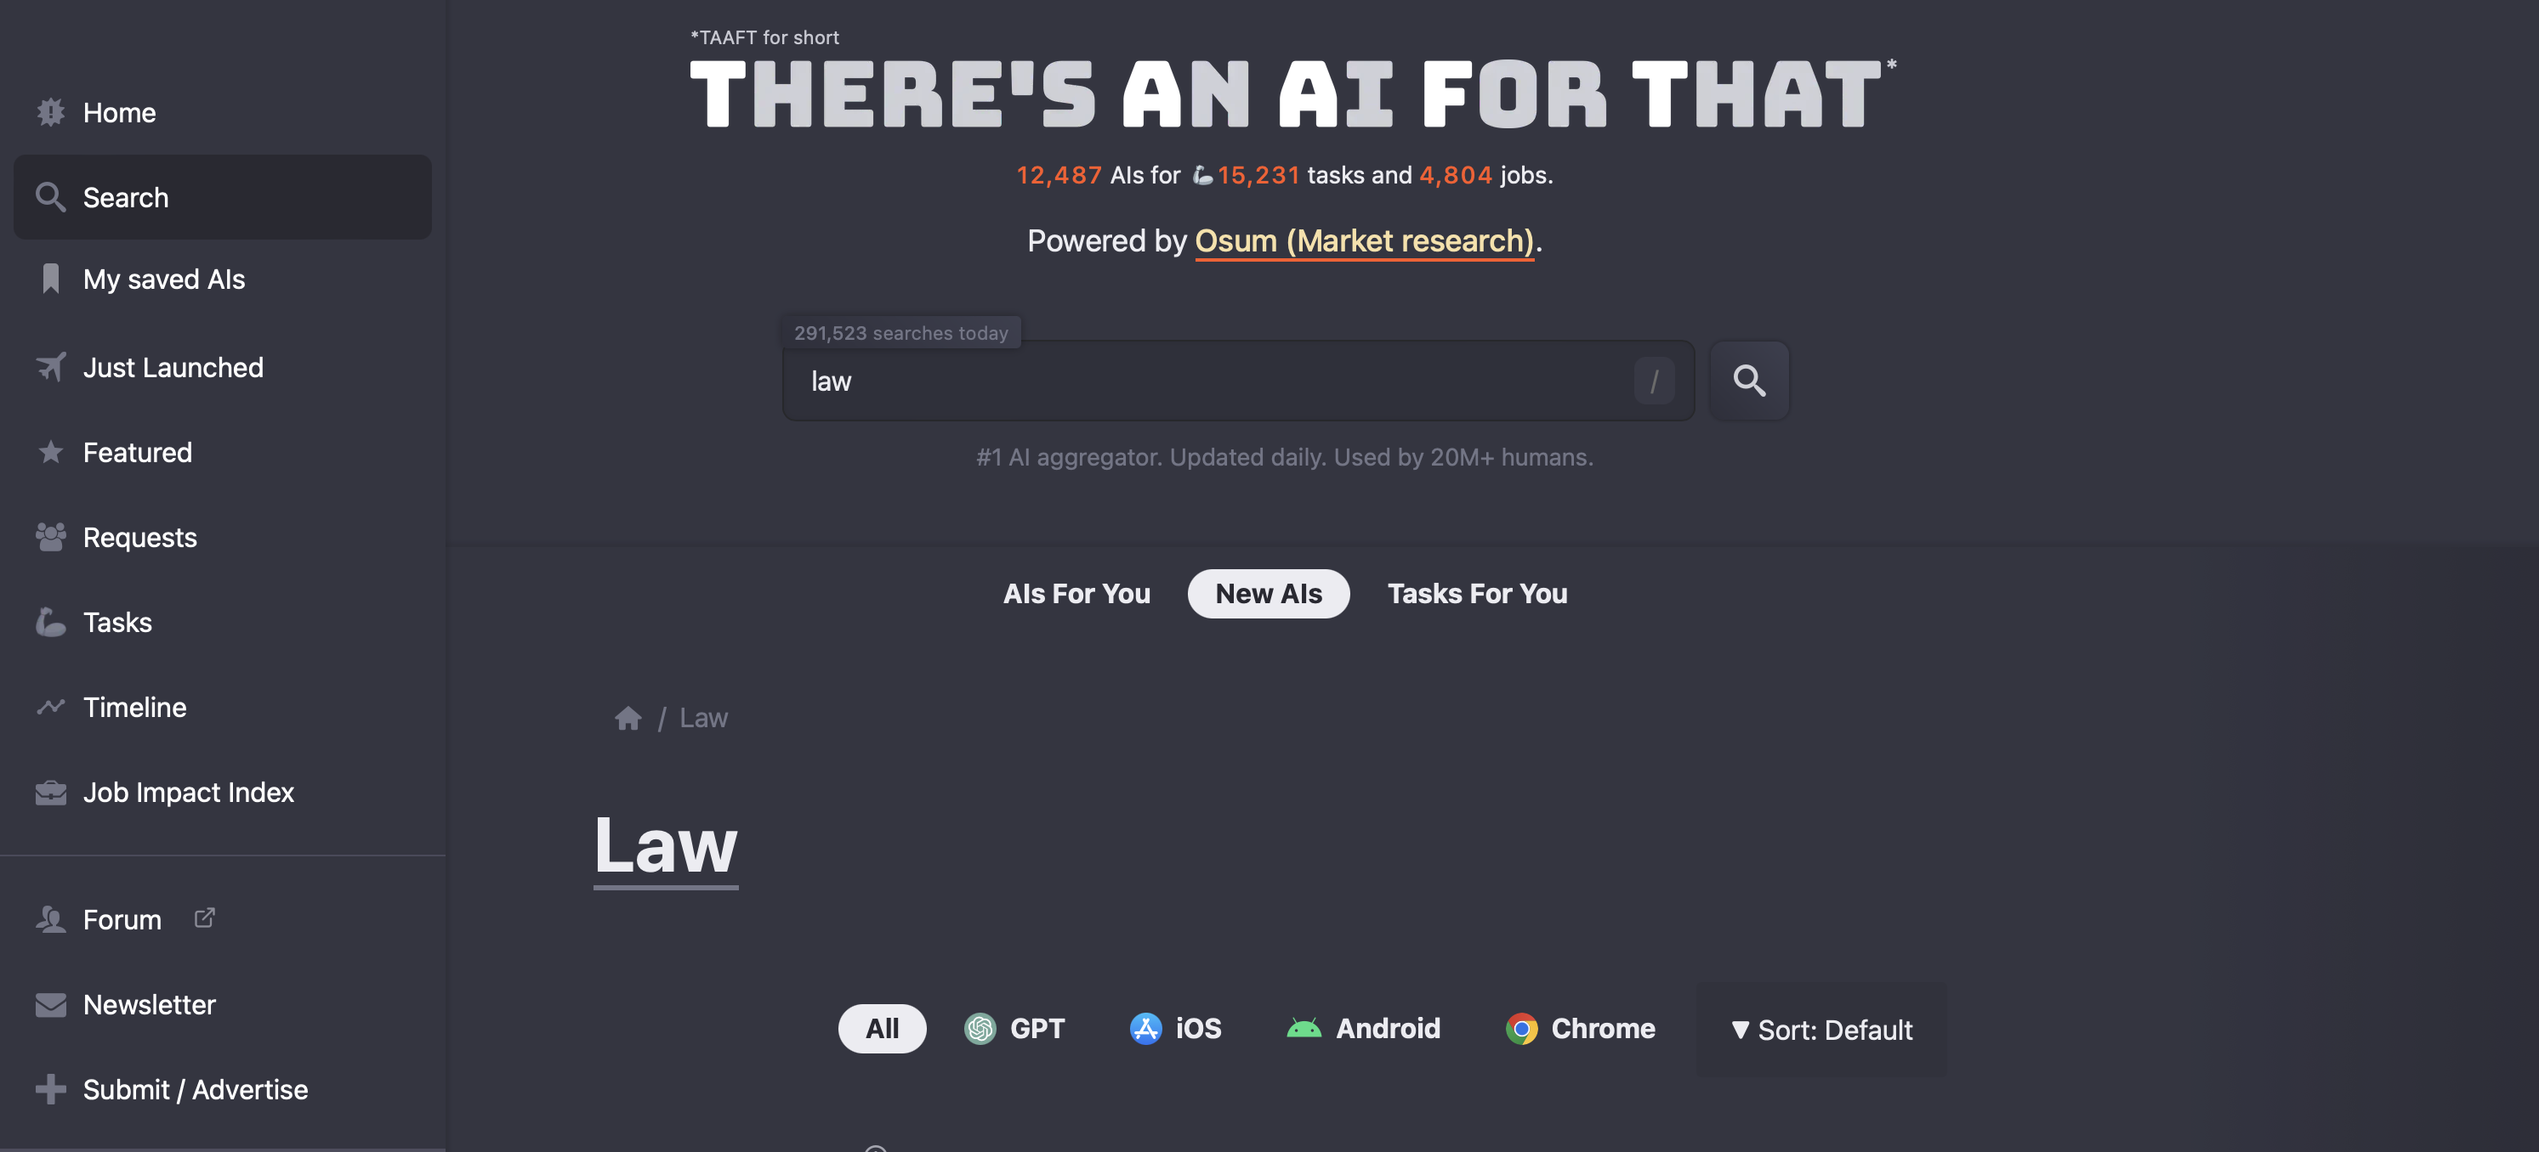
AI and legal ethics
Client and consumer use of AI legal tools
Notes:
May 12, 2024:
Searches on “law” = 336
Searches on “legal” = 462
Not limited to law; not limited to U.S.

Slide 29
AI and legal ethics … and UPL
Client and consumer use of AI legal tools
  SUPPOSE: AI tool provides consumer facing eviction, after being provided copy of lease and other specific details, a complete playbook for her defense, including forms and scripts for how to address court and present case in court.
    UPL?
Notes:
Does it matter if a consumer pays for the service?
What if the service is developed and paid for by the local Legal Services Corporation affiliate and provided by them free to consumers on their website?
What if nonlawyer volunteers with the local Legal Services Corporation affiliate guide consumers through using the tool?

Slide 30
AI and legal ethics … and UPL
Client and consumer use of AI legal tools
  SUPPOSE: AI tool answers a range of legal questions from a business’ sales force about all kinds of questions that salespeople usually ask the company’s law department, including everything from the meaning of contract terms, to permitted adjustments to terms, to gratuities to buyers, to discussions with competitors.
    UPL?
Notes:
Does it matter if the business has a law department or not or, if the business has a law department, if the law department is who deploys the service?
Is the information provided to the tool privileged?

Slide 31
AI and legal ethics … and UPL
  ABA Task Force on the Model Definition of the Practice of Law (Sept. 18, 2002, Draft)
(b) Definitions:
(1) The "practice of law" is the application of legal principles and judgment with regard to the circumstances or objectives of a person that require the knowledge and skill of a person trained in the law.

Slide 32
AI and legal ethics … and UPL
  ABA Task Force on the Model Definition of the Practice of Law (Sept. 18, 2002, Draft)
(c) A person is presumed to be practicing law when engaging in any of the following conduct on behalf of another:
(1) Giving advice or counsel to persons as to their legal rights or responsibilities or to those of others;
(2) Selecting, drafting, or completing legal documents or agreements that affect the legal rights of a person;
(3) Representing a person before an adjudicative body, including, but not limited to, preparing or filing documents or conducting discovery; or
(4) Negotiating legal rights or responsibilities on behalf of a person.

Slide 33
AI and legal ethics … and UPL
Tex. Gov't Code Ann. § 81.101(c)
(c) In this chapter, the “practice of law” does not include the design, creation, publication, distribution, display, or sale, including publication, distribution, display, or sale by means of an Internet web site, of written materials, books, forms, computer software, or similar products if the products clearly and conspicuously state that the products are not a substitute for the advice of an attorney. This subsection does not authorize the use of the products or similar media in violation of Chapter 83 [UPL] and does not affect the applicability or enforceability of that chapter.

Slide 34
AI and legal ethics … and UPL
A modest proposal to reform UPL
(___) For purposes of [insert reference to UPL prohibition], the “practice of law” does not include the design, creation, or dissemination (including without limitation publication, distribution, display, provision of access, or sale) of any publication, software, application, digital content, or any digital offerings, including without limitation products or services based on or employing artificial intelligence, if the product or service clearly and conspicuously states that:
  ….

Slide 35
AI and legal ethics … and UPL
A modest proposal to reform UPL
(___) [It’s not UPL…] if the product or service clearly and conspicuously states that:
  (1) providing or receiving the products or services does not establish an attorney-client relationship;
  (2) communications with the service provider or seller are not protected by attorney-client privilege; and
  (3) the services or products, as legal information, are not a substitute for the advice of an attorney.

Slide 36
AI is not UPL.
A modest proposal to reform UPL
(___) …
For purposes of this section, “artificial intelligence” means a computational system that is designed to generate legal information, documents, recommendations, or responses based on statistical, machine learning, algorithmic, or natural language processing techniques.
Any product or service that complies with these disclosure requirements shall not be subject to restrictions regarding the “practice of law.

Slide 37
AI is not UPL.
A modest proposal to reform UPL
  Lucian T. Pera, “A Simple Law That Would Unshackle AI for Legal Use,” Law Practice, Sept. 2, 2025 (ABA), https://www.americanbar.org/groups/law_practice/resources/law-practice-magazine/2025/september-october-2025/ai-for-legal-use/

Slide 38
Today’s moral… maybe.

Slide 39

AI and legal ethics
Questions?
Lucian T. Pera
lucian.pera@arlaw.com • 901-524-5278

